Slide 1
Belső oktatás
SPRING

Slide 2
SPRING
Java alkalmazás keretrendszer
Az EJB alternatívájaként emlegetik
Általában kiegészíti azt

Slide 3
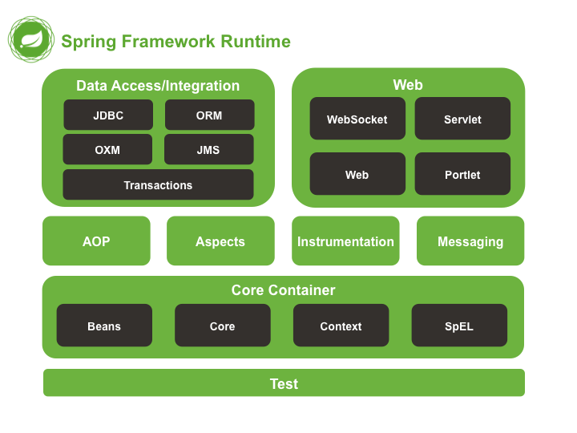
SPRING Modulok

Slide 4
CORE
Dependency Injection (DI)
Inversion of Control (IoC)
IoC container

Slide 5
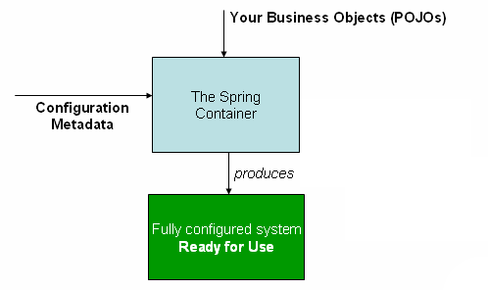
IoC container

Slide 6
Configuration metadata
XML-alapú
Annotáció-alapú
Java-alapú

Slide 7
Ioc
XML
Annotáció
Java
<bean id="helloWordBeanXML" class="hu.neuron.java.core.example.HelloWordBeanXML">
</bean>
@Component /@Service / @Repository
public class HelloWordBean
@Bean
public HelloWordBeanJava helloWordBean()

Slide 8
Ioc static factory
XML
Java
<bean id="helloWordRunnerXMLFromStaticFactory"
class="hu.neuron.java.core.example.HelloWordRunnerStaticFactory"
factory-method="createInstance" />
private static HelloWordBeanXML helloWordBeanXML = new HelloWordBeanXML();
private static HelloWordRunnerXML helloWord = new HelloWordRunnerXML();
private HelloWordRunnerStaticFactory() {}
public static HelloWordRunnerXML createInstance() {
helloWordRunnerXML.setHelloWordBeanXML(helloWord);
return helloWordRunnerXML;
}

Slide 9
Ioc instance factory
XML
Java
<bean id="helloWordRunnerFactory„ class="hu…...HelloWordRunnerFactory">
<property name="helloWordBeanXML">
<ref bean="helloWordBeanXML" />
</property></bean>
private HelloWordBeanXML helloWordBeanXML;
private static HelloWordRunnerXML helloWord = new HelloWordRunnerXML();
private HelloWordRunnerFactory() {
}
public HelloWordRunnerXML createInstance() {
helloWordRunnerXML.setHelloWordBeanXML(helloWord);
return helloWordRunnerXML;
}

Slide 10
Lazy-inaitialized
Implicit
@Lazy
Global
<bean id="helloWordRunnerXML" class="hu.neuron.java.core.example.HelloWordRunnerXML" lazy-init="true">
<property name="helloWordBeanXML">
<ref bean="helloWordBeanXML" />
</property>
</bean>
<beans default-lazy-init="true">

Slide 11
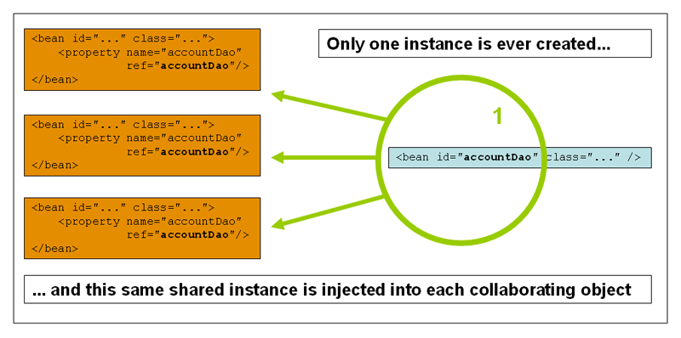
Scope Singleton

Slide 12
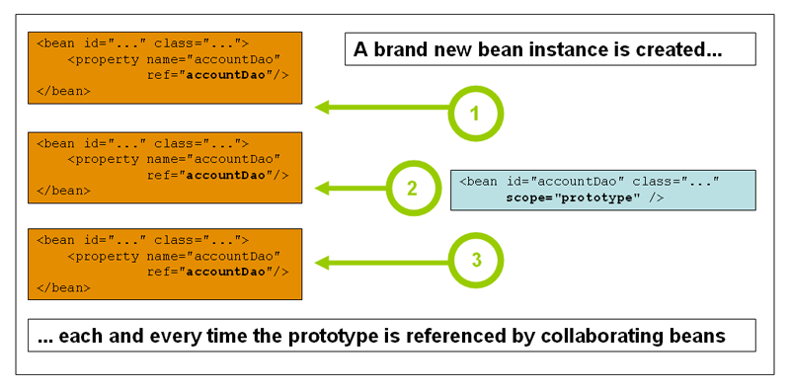
Scope prototype

Slide 13
Dependency Injection
XML
Setter-based
<bean id="helloWordRunnerXML„ class="hu.neuron.java.core.example.HelloWordRunnerXML">
<property name="helloWordBeanXML">
<ref bean="helloWordBeanXML" />
</property>
</bean>

Slide 14
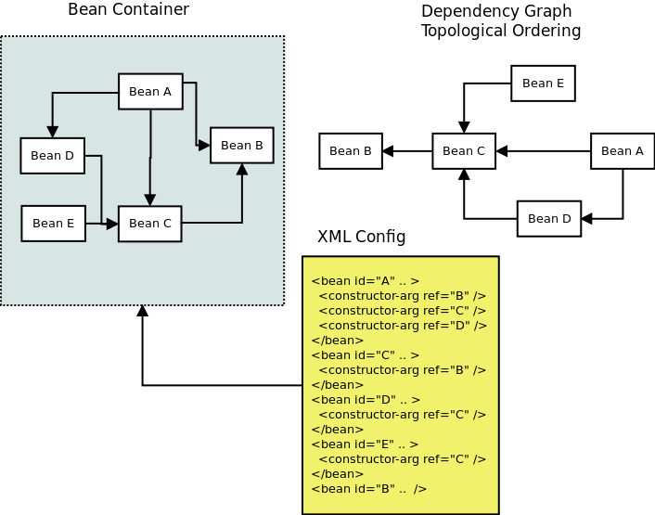
Dependency Injection

Slide 15
Dependency Injection
XML
Constructor-based
@Required
<bean id="helloWordRunnerConstXML" class="hu.neuron.java.core.example.HelloWordRunnerConstXML">
<constructor-arg name="helloWordBeanXML" ref="helloWordBeanXML" />
</bean>

Slide 16
Dependency Injection
Annotáció
@Autowired(required=false)
@Autowired
private HelloWordBean helloWordBean;
@Autowired
public HelloWordRunnerConst(HelloWordBean helloWordBean) {
this.helloWordBean = helloWordBean;
}

Slide 17
Dependency Injection
XML konfiguráció injection módok
no
byName
byType
constructor
Konfiguráció
<beans default-autowire="default">

Slide 18
Életciklus kezelés
Inicializálás
@PostConstruct
init-method="init”
@Bean(initMethod = "init")
Felszabadítás
@PreDestroy
destroy-method="cleanup"
@Bean(destroyMethod = "cleanup")

Slide 19
Életciklus figyelés
ApplicationListener
ContextRefreshedEvent
ContextStartedEvent
ContextStoppedEvent
ContextClosedEvent
RequestHandledEvent

Slide 20
JDBC
JdbcTemplate
execute
update
batchUpdate
query
queryForObject
RowMapper

Slide 21
DataSource
<bean id="dataSource" class="org.apache.commons.dbcp.BasicDataSource"
destroy-method="close">
<property name="driverClassName" value="${jdbc.driverClassName}" />
<property name="url" value="${jdbc.url}" />
<property name="username" value="${jdbc.username}" />
<property name="password" value="${jdbc.password}" />
</bean>

Slide 22
transaction
<bean id="transactionManager"
class="org.springframework.jdbc.datasource.DataSourceTransactionManager">
<property name="dataSource" ref="dataSource" />
</bean>
<tx:annotation-driven />

Slide 23
Transactional Annotation
@Transactional(propagation = Propagation.REQUIRED)

Slide 24
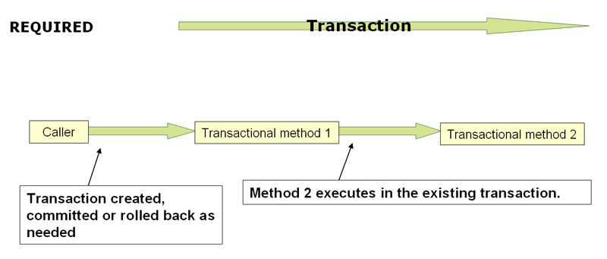
Required

Slide 25
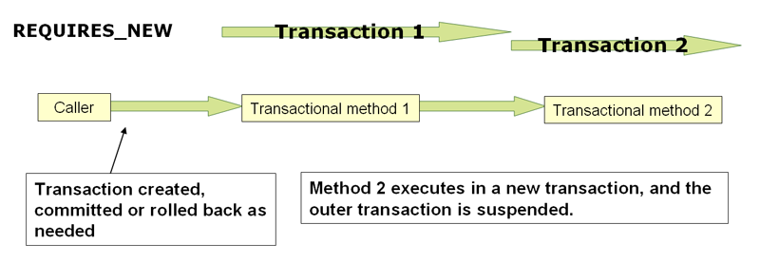
RequiresNew

Slide 26
Security
Security constraint
<security:http auto-config="true" use-expressions="true">
<security:intercept-url pattern="/secured/**"
access="hasRole('USER')" />
<security:form-login login-page="/public/login.jsp"
default-target-url="/index.jsp"
authentication-failure-url="/public/login.jsp?error=1"
username-parameter="username"
password-parameter="password" />
<security:logout logout-success-url="/index.jsp" />
</security:http>

Slide 27
Security
Config
<security:authentication-manager>
<security:authentication-provider
user-service-ref="customUserDetailsService">
<security:password-encoder hash="bcrypt" />
</security:authentication-provider>
</security:authentication-manager>

Slide 28
Security
Web.xml
<filter>
<filter-name>springSecurityFilterChain</filter-name>
<filter-class>
org.springframework.web.filter.DelegatingFilterProxy
</filter-class>
</filter>
<filter-mapping>
<filter-name>springSecurityFilterChain</filter-name>
<url-pattern>/*</url-pattern>
</filter-mapping>

